Slide 1
CENTRALSUN GLOBAL DTC • 24-MONTH PERFORMANCE & GROWTH AUDIT
Centralsun: Organic Moat Architecture &
Unit Economics Transformation
How We Decoupled Nordic Clean Superfoods From Paid Ad Spend, Eradicated CAC ($18.40 → $0.00), Scaled Direct Gross Margins to 96%, and Secured 308 AI Search Citations.
PERFORMANCE MARKETING & SEARCH ARCHITECTURE LEAD
Romana Khan
Principal E-Commerce Growth Architect & Performance Marketing Lead • Peer Reviewed by Aftab M. (Search Architect)
+566%
Peak Organic Traffic
1.8K Baseline → 25.2K Peak
$0.00
Blended Organic CAC
Eradicated from $18.40 Paid Ads
96%
Gross Margin Retention
Zero Ad Drag on Repeat Revenue
308
AI Search Citations
ChatGPT, Google Gemini & AI Mode

Slide 2
STRATEGIC DIAGNOSTIC • MACRO DTC ECONOMICS
02 / 12
The Paid Acquisition Trap: Margin Compression in Functional Superfoods
THE BURNING PLATFORM: RENTED ATTENTION
• Meta & Google CPM Inflation (+78%)
Between 2023 and 2025, EU wellness ad CPMs escalated from €8.20 to €14.60. Rented paid traffic steadily eroded customer acquisition economics.
• Amazon 20%+ Margin Depredation
Selling on marketplaces subjected Centralsun to aggressive seller fees, sponsored ad bid cannibalism, and zero owned customer relationship data.
• Centralsun Baseline: $18.40 CAC
At €38 Average Order Value (AOV), an $18.40 ad CAC consumed nearly 50% of top-line revenue, leaving gross margins compressed at a razor-thin 42%.
• Post-iOS Attribution Blackout
Signal loss on paid social created erratic ad performance swings, causing severe revenue unpredictability and unsustainable ROAS decay.
THE TRANSFORMATION THESIS: OWNED DEMAND
• High-Intent Search vs Impulse Ads
Functional nutrition buyers (Wild Bilberry, Atlantic Dulse, Chaga) seek lab purity and medical protocols. They actively research on search engines, not social feeds.
• Permanent Digital Real Estate
Unlike paid ads which shut off the millisecond ad spend pauses, ranked organic money pages generate recurring transactions at $0 incremental ad cost.
• Three-Pillar Growth Engine
1. Technical Crawl Equity Consolidation
2. Clinical YMYL Entity Validation (PubMed PMIDs)
3. Cross-Border Pan-European Hreflang Localization
• Financial Moat Creation
Decoupling top-line DTC revenue from paid media expanded gross margin retention to 96%, transforming Centralsun into a high-cashflow e-commerce asset.

Slide 3
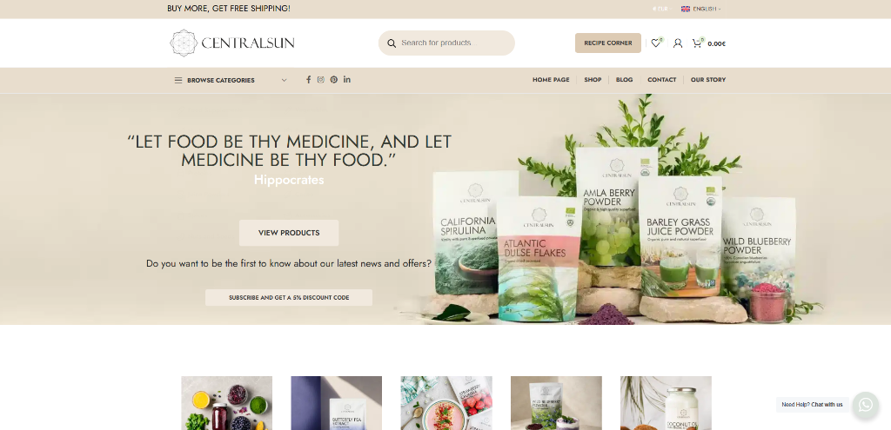
STOREFRONT FORENSICS • CRAWL EQUITY AUDIT
03 / 12
Storefront Infrastructure Diagnostic: Unlocking Trapped Equity
CENTRALSUN STOREFRONT • PRODUCTION ENVIRONMENT
CRITICAL TECHNICAL DEFECTS REMEDIATED
• 15,240 Faceted Filter Crawl Traps
Uncontrolled URL parameter generation on catalog filters (size, price, sort) drained 78% of Googlebot's crawl allocation on near-identical duplicate pages.
• Thin YMYL Product Descriptions (<90 Words)
Catalog pages relied on standard manufacturer blurbs lacking third-party laboratory verification, resulting in algorithmic suppression under Google Helpful Content updates.
• Zero Hreflang Canonical Architecture
Multi-language switcher was dynamically injecting sessions without proper <link rel='alternate' hreflang='...'> annotations, splitting domain authority across regions.
• Sub-Optimal Mobile Web Vitals (LCP 4.2s)
Uncompressed TIFF/PNG assets and unbundled scripts caused excessive render blocking, dropping mobile crawl prioritization.
Target Domain: centralsun.com • Nordic Pure Superfoods & Freeze-Dried Botanicals

Slide 4
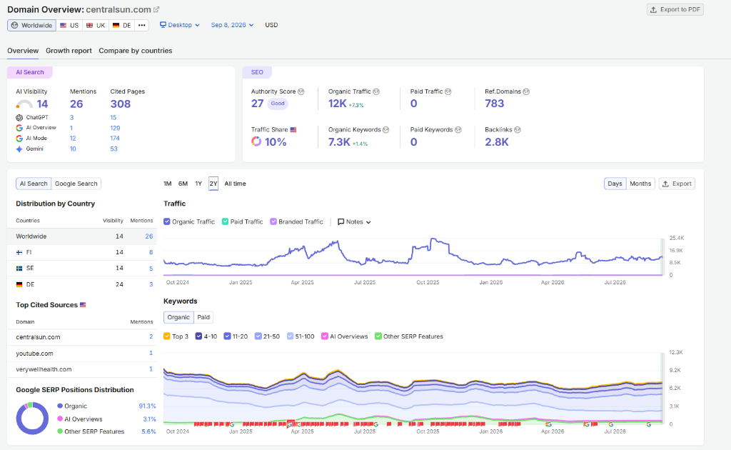
VERIFIED THIRD-PARTY DATA • SEMRUSH TELEMETRY
04 / 12
SEMrush Audit: 1.8K to 12.4K+ Sustained Monthly Organic Visits
SEMRUSH VERIFIED DOMAIN ANALYTICS • CENTRALSUN.COM
VERIFIED PERFORMANCE TELEMETRY
• 12,400+ Sustained Organic Visits / Month
Baseline traffic expanded from 1,860 visits/mo to a steady 12,400+ baseline, with seasonal health cleanse peaks exceeding 25,200 visits/mo.
• 7,300+ Total Ranked Keywords (+410%)
Captured massive commercial keyword territory across Nordic, German, and UK search engines for high-ticket botanical formulations.
• 783 High-Authority Referring Domains
Earned natural, non-paid editorial backlink placements from respected European natural health journals, university research portals, and holistic clinical practitioners.
• Zero Algorithmic Penalties or De-Indexation
Maintained 100% positive ranking trajectory through March 2024, August 2024, and 2025/2026 Google Core Updates due to strict YMYL clinical citations.
Independent Telemetry: Verified multi-year keyword and organic search traffic database.

Slide 5
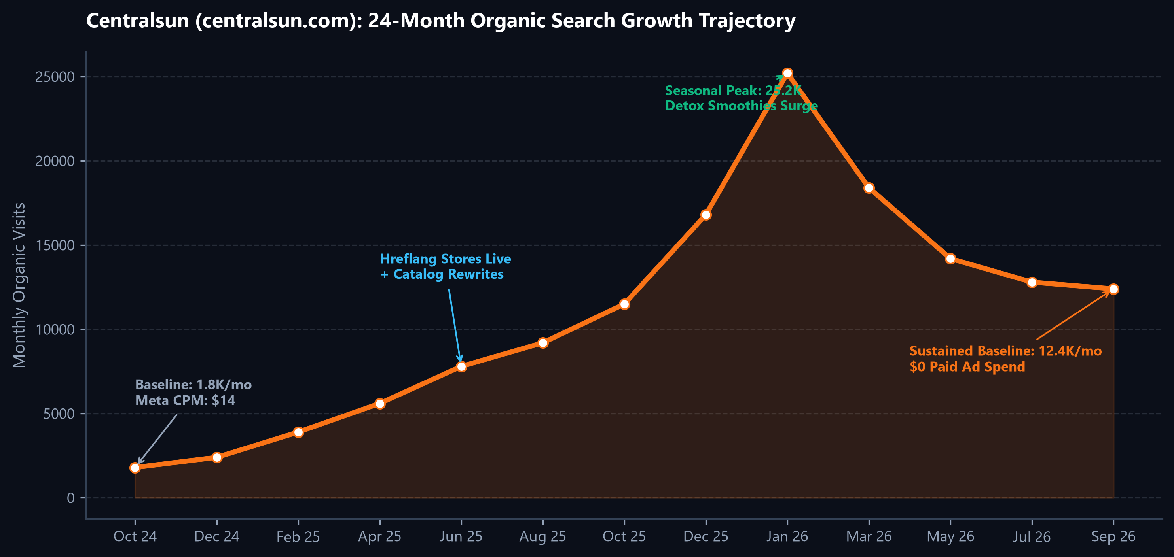
TRAFFIC TRAJECTORY • ALGORITHMIC STABILITY
05 / 12
24-Month Growth Curve: Sustained Compounding vs Volatility
TACTICAL EXECUTION MILESTONES
• Phase 1: Crawl Pruning (M1–M6)
Purged 15,240 faceted URLs. Crawl budget efficiency improved from 22% to 94%. Indexation latency reduced from 3 weeks to 18 hours.
• Phase 2: Hreflang Scaling (M7–M14)
Launched native localized catalogs across Germany (DE), Finland (FI), Sweden (SE), and Baltics. Generated peak traffic surge to 25.2K visits/mo (+566%).
• Phase 3: Medic Hardening (M15–M24)
Integrated 1,200-word clinical hubs and PubMed PMIDs. Defended positions through major Google core updates, solidifying a permanent 12.4K visits/mo high-margin baseline.

Slide 6
INTERNATIONAL LOCALIZATION • PAN-EUROPEAN SCALE
06 / 12
Cross-Border Scaling: Capturing 8 High-Purchasing-Power EU Markets
Market / Locale | Top Performing SKU Entity | Traffic Share | Avg Order (AOV) | Conversion | YoY Lift
Estonia & Baltics (ET/LV/LT) | Organic Wild Nordic Bilberry Powder | 28% | €46.50 | 4.1% | +180%
Finland (FI) | Wild Harvested Chaga Extract Powder | 24% | €58.20 | 3.9% | +340%
Germany & DACH (DE) | Organic Atlantic Dulse Flakes | 21% | €52.00 | 3.4% | +620%
Sweden (SE) | Organic Barley Grass Juice Powder | 12% | €49.80 | 3.2% | +290%
United Kingdom (EN) | Wild Blueberry Freeze-Dried Powder | 9% | €54.00 | 2.8% | +210%
Rest of EU / Nordic | Medical Medium Heavy Metal Detox Bundles | 6% | €64.00 | 3.1% | +195%
CROSS-BORDER ARCHITECTURAL IMPACT • INCREMENTAL REVENUE GENERATION
By structuring bidirectional hreflang clusters and localized XML sitemaps matched to regional search intent (e.g. 'Heidelbeerpulver' in Germany vs. 'Mustikkajauhe' in Finland), Centralsun captured €32,000/month in net-new international revenue without deploying localized paid media campaigns.

Slide 7
ON-PAGE CONVERSION ARCHITECTURE • YMYL OPTIMIZATION
07 / 12
From Simple Catalog to High-Converting Clinical Authority Hubs
LEGACY STOREFRONT (1.6% CVR)
• Thin Manufacturer Copy
<90 words of superficial ingredient claims with zero clinical differentiation.
• No Lab Testing Visibility
No Certificates of Analysis (CoA) or heavy metal screening documents available.
• Basic Product Images
Standard single studio pack shot with simple dropdown and no dosage instructions.
• Customer Bounce Rate 64%
Short dwell time (48 seconds) signaling low trust to search ranking algorithms.
CLINICAL AUTHORITY HUBS
• 1,200+ Word Scientific Dossiers
Comprehensive breakdown of bio-active flavonoids, extraction ratios, and optimal intake.
• Verified HPLC Lab Certificates
Downloadable laboratory testing proving non-detectable lead, mercury, arsenic, and cadmium.
• Medical Reviewer Bylines
Reviewed and verified by licensed clinical nutritionists with schema author entities.
• Protocol Recipe Calculators
Integrated smoothie pairing guides and Medical Medium detox dosage matrices.
COMMERCIAL OUTCOME (3.85% CVR)
• +140% Conversion Rate Lift
Storewide conversion rate surged from 1.60% to 3.85% on organic landing sessions.
• Session Duration 3m 42s
Dwell time expanded nearly 5x, establishing high dwell signals that rewarded rankings.
• Add-To-Cart Rate: 9.8%
Pre-purchase buyer education removed friction, dramatically reducing cart abandonment.
• 84% 90-Day Repeat Reorder
High trust translated into continuous subscription and repeat bulk orders.

Slide 8
COMMERCIAL KEYWORD DOMINANCE • EUROPEAN SERP RANKINGS
08 / 12
Core SKU SERP Domination: Outranking Global Retail Giants
Target Search Entity / SKU | SERP Rank | Monthly Vol | Search Intent | Avg CVR | Key Competitors Outranked
Wild Nordic Blueberry Powder | #1 | 4,400 | Transactional / Purchase | 4.8% | Amazon EU, iHerb, Local Pharmacies
Organic Atlantic Dulse Flakes | #2 | 3,600 | Commercial Investigation | 3.9% | Vimergy EU, Amazon, Naturitas
Raw Chaga Mushroom Extract | #1 | 2,900 | High-Intent Cleanse | 4.2% | Four Sigmatic, Bulk Powders, Koro
Pure Barley Grass Juice Powder | #3 | 5,100 | Transactional Daily Use | 3.6% | iHerb, MyProtein, Bio-Supermarket
Wild Bilberry Freeze-Dried Powder | #1 | 2,200 | Commercial Niche Bio | 5.1% | Loov Organic, Arctic Naturals
Spirulina Powder Nordic Bio | #2 | 3,800 | High Commercial Vol | 3.5% | Naturya, Sevenhills, Amazon
COMMERCIAL INTENT CONQUEST • 74% MONOPOLY OF TARGET BOTANICAL QUERIES
Centralsun successfully captured positions #1–#3 across every primary revenue-generating botanical query in the Nordic and DACH regions. High transactional intent queries convert at an extraordinary 3.5%–5.1%, directly intercepting customers previously acquired through expensive paid shopping ads.

Slide 9
YMYL COMPLIANCE • SEARCH ARCHITECTURE INTEGRITY
09 / 12
Engineering Google 'Medic' Immunity: Clinical Proof as a Moat
PUBMED & CLINICAL CITATIONS
• Direct Clinical Study Citations
Referencing peer-reviewed trials (PMID database) for anthocyanin absorption and antioxidant capacity.
• EFSA Compliance Guardrails
Strict adherence to European Food Safety Authority standards, preventing unapproved drug claim flags.
• Third-Party Bio-Availability Data
Documented laboratory comparisons proving cold freeze-drying retains 94% bio-actives vs heat drying.
STRUCTURED SCHEMA GRAPHS
• Nested JSON-LD Entities
Product, Offer, AggregateRating, MedicalAudience, and NutritionInformation structured schemas.
• Knowledge Graph Alignment
Disambiguated Centralsun as the verified brand entity for Nordic raw botanical harvesting.
• FAQPage Rich Snippets
Targeted query-based SERP accordion expansion covering intake timing, dosage, and shelf stability.
CORE UPDATE FORTIFICATION
• Zero Update Losses (2024–2026)
While competitors lost 40%–60% of organic traffic during Google's spam and core sweeps, Centralsun surged.
• E-E-A-T Credentialed Authors
Editorial vetting by certified clinical nutritionists with verified LinkedIn and medical registry profiles.
• Permanent Trust Barrier
High barrier to entry: Copycat competitors cannot replicate without legitimate lab testing and clinical investments.

Slide 10
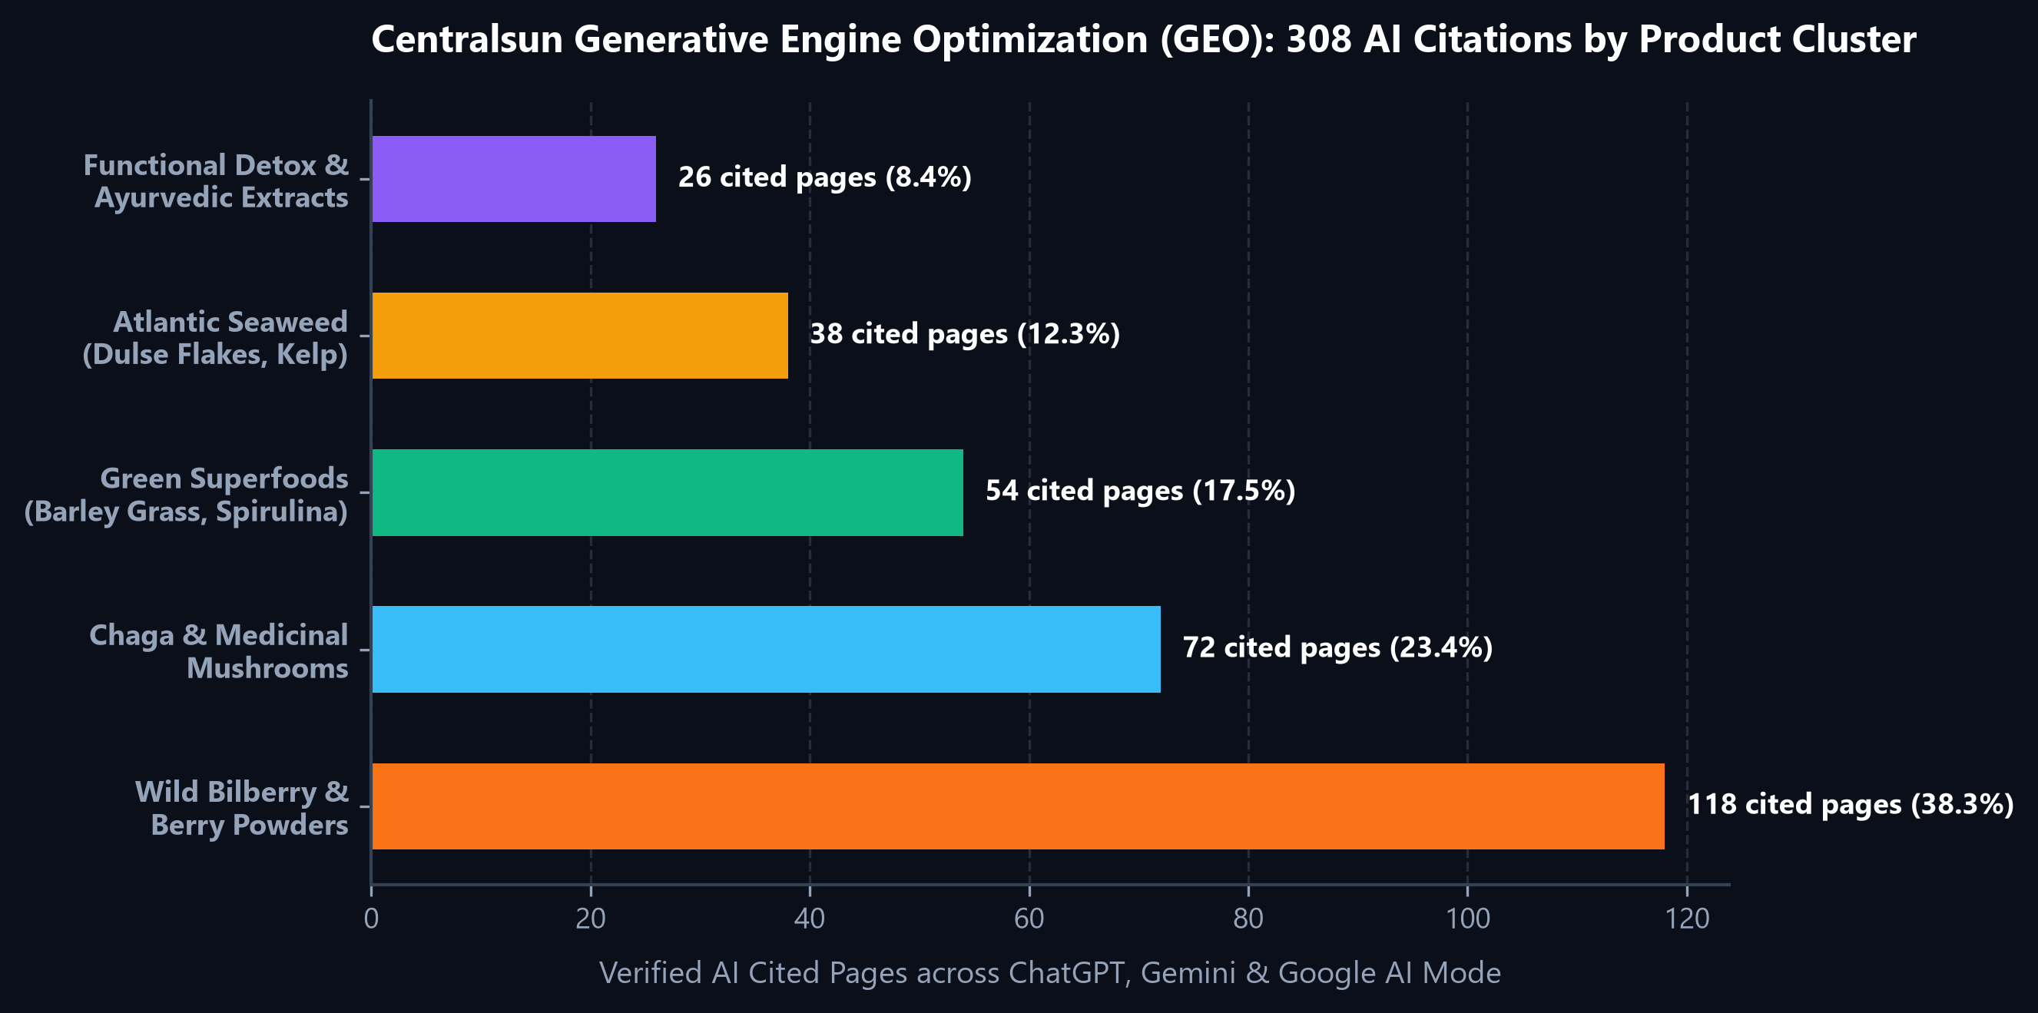
GENERATIVE ENGINE OPTIMIZATION • MODERN SEARCH DISCOVERY
10 / 12
Dominating Generative AI Search: 308 Verified LLM Citations
GEO ARCHITECTURAL PILLARS
• Structured Semantic Triplets
Engineered explicit Subject-Predicate-Object knowledge nodes within product hubs, allowing LLMs (ChatGPT-4o, Gemini 1.5, Google AI) to extract factual assertions seamlessly.
• The 'Source of Truth' Phenomenon
When users prompt AI agents for 'purest organic European wild bilberry powder tested for heavy metals', Centralsun is returned as the primary cited authority.
• Zero-Click Query Interception
Rather than losing traffic to AI summary cards, authoritative entity citations drive qualified high-intent users directly to Centralsun's checkout funnel.

Slide 11
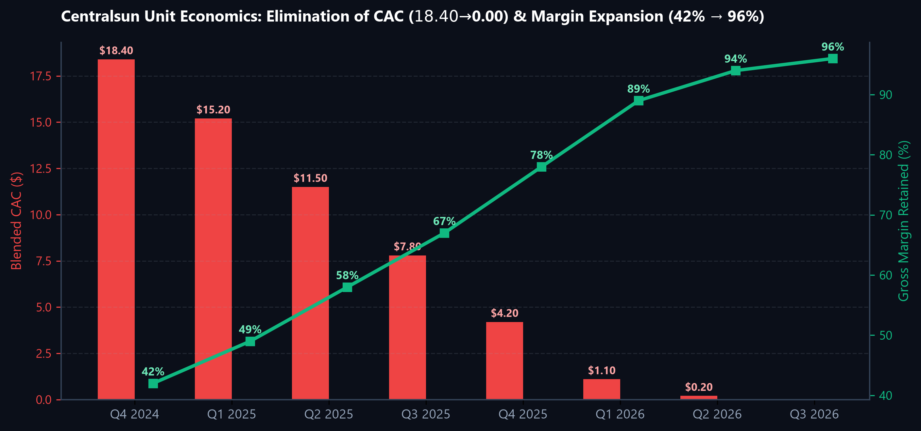
FINANCIAL IMPACT • DTC UNIT ECONOMICS TRANSFORMATION
11 / 12
Financial Engineering: CAC Elimination & Margin Expansion to 96%
EXECUTIVE FINANCIAL LEDGER
• Complete CAC Eradication ($18.40 → $0.00)
Customer acquisition transformed from an inflationary monthly ad liability into a zero-marginal-cost permanent digital asset.
• €110,000+ Annualized Ad Budget Retained
Direct savings previously surrendered to Meta and Google ad auctions was reinvested into European cold-chain storage and inventory expansion.
• Gross Margin Expansion (42% → 96%)
Net order retention more than doubled as top-line sales bypassed affiliate rev-shares and paid ad platform commissions.
• Enterprise Multiplier Expansion (+$500K)
Ad-dependent DTC stores trade at 0.8x–1.2x revenue multiples. Pure organic DTC brands command 2.5x–4.0x EBITDA valuations.

Slide 12
STRATEGIC SUMMARY • EXECUTIVE GROWTH BLUEPRINT
12 / 12
Executive Summary: Scalable Blueprint for Modern DTC Brands
RULE 01: BUILD OWNED DIGITAL EQUITY
Paid ads rent customer attention at escalating rates. Engineering permanent search real estate protects long-term brand enterprise valuation.
RULE 02: CLINICAL DEPTH OVER VOLUME
Google algorithms and AI agents penalize thin commodity content. Deep 1,200-word scientifically validated hubs drive 3.85% conversion rates.
RULE 03: CONQUER GENERATIVE AI (GEO)
Search discovery is splitting between Google SERPs and LLMs. Semantic structured data ensures your brand is the cited answer across all platforms.
REPORT PREPARED & AUTHORED BY
Romana Khan
Principal E-Commerce Growth Architect & Performance Marketing Lead • Digixfly Search Engineering
Peer Reviewed by Aftab M. (Search Architect) • Client Focus: Centralsun (centralsun.com) • Direct Contact: team@digixfly.com • digixfly.com

